Slide 1
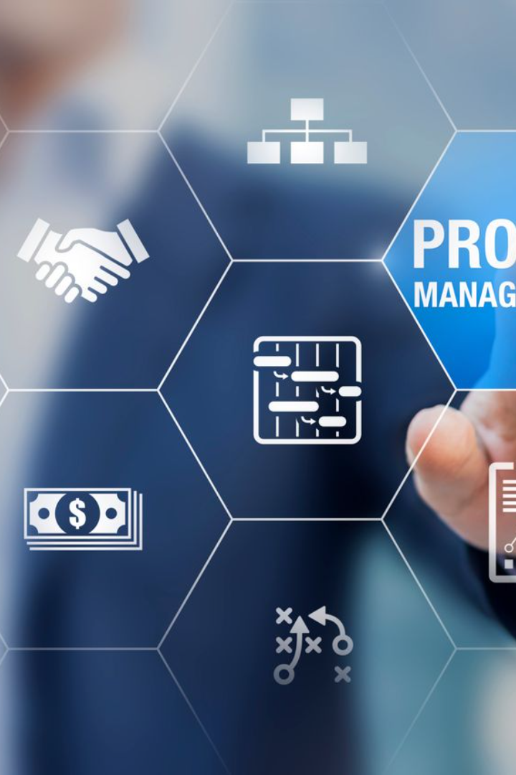
Project Planning
Effective project planning is essential for successful execution. Learn about planning methodologies, Gantt charts, timelines, and resource allocation.

Slide 2

Planning Methodologies
Waterfall Model
Agile Methodology
Scrum Framework
A traditional sequential approach with distinct project phases, ensuring proper planning and execution.
A flexible and iterative approach that encourages collaboration, adaptability, and continuous improvement.
A specific agile framework that focuses on delivering frequent results through short development cycles called sprints.

Slide 3
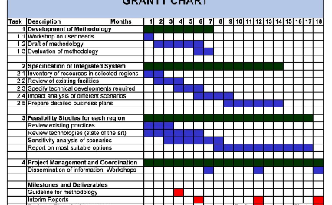
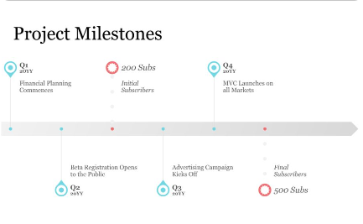
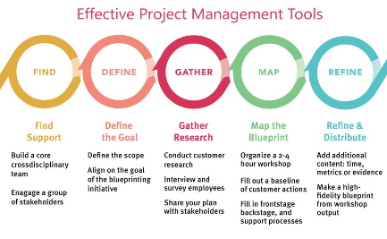
Gantt Charts and Timelines
Gantt Charts
Timelines
Project Management Tools
A visual representation of project tasks, timelines, and dependencies, enabling effective scheduling and resource allocation.
Visualize your project's chronological sequence, highlighting important milestones and potential bottlenecks.
Discover modern software solutions to create and manage Gantt charts and timelines efficiently.

Slide 4

Resource Allocation
1
Human Resources
2
Equipment and Tools
3
Time and Budget
Ensure the right team members with appropriate skills and expertise are assigned to each project task.
Efficiently distribute time and financial resources to meet project requirements while optimizing productivity.
Allocate necessary resources such as hardware, software, and tools to support project execution.

Slide 5
Effective Project Planning
1
1. Define Project Scope
Clearly outline project objectives, deliverables, constraints, and stakeholders' expectations.
2. Prepare Work Breakdown Structure
2
Divide the project into manageable tasks, creating a hierarchical structure for better planning and organization.
3
3. Estimate Resources and Time
Determine the required resources, including human and material resources, along with estimated timelines for each task.

Slide 6
Creating a Project Schedule
Gantt Charts
Resource Management
Risk Assessment
Use Gantt charts to visually represent the project schedule, including task durations, dependencies, and milestones.
Identify potential risks and plan mitigation strategies to ensure proactive risk management throughout the project.
Allocate resources efficiently, considering availability, skills, and dependencies, to avoid bottlenecks and maximize productivity.

Slide 7
Optimizing Resource Allocation
Resource Tracking
Collaborative Tools
Implement robust resource tracking mechanisms to monitor resource utilization, identify variances, and make necessary adjustments.
Utilize project management software and collaborative tools to facilitate effective communication, coordination, and resource allocation.

Slide 8

Conclusion: Project Planning Success
1
Clear Roadmap
2
Effective Resource Management
3
Continuous Evaluation
Proper project planning provides a clear roadmap for successful execution, ensuring tasks are completed within the set timeframe.
Optimizing resource allocation leads to improved productivity, reduced risks, and better overall project outcomes.
Regularly evaluate and adjust the project plan to adapt to changing requirements and optimize resource allocation.

